Slide 1

Thesis Title: Tumor Identification in CT and MRI Imaging Using Deep Learning for Accurate Diagnosis
Bachelor Student : Anjeza Kanxha
Epoka University

Slide 2
Abstract
Deep Learning with Convolutional Neural Networks has become a powerful tool for solving a wide range of real-life problems. Image classification and medical imaging are cases of implementation of deep learning, a subset of Machine Learning. Deep learning has a high success rate, due to its variety of algorithms and the ability to learn complex patterns directly from data.
This thesis aims to test the effectiveness of the Convolutional Neural Network, in detecting tumors and classifying different medical images in tumoral or healthy. This model will be trained and tested on our chosen datasets for its accuracy and other performance metrics. The performance was satisfying with high accuracy, during training and testing on unseen data.

Slide 3

Acknowledgements
Special thanks to Assoc. Prof. Dr. Dimitros Karras for guidance and support throughout the research process.

Slide 4
Table of Contents
1. Introduction
2. Objectives
3. Literature Review
4. Methodology
4.1. Model Architecture
4.2. Experimental setup and training
5. Results
5.1. Summary of results
6. Discussion
7. Conclusions
8. Future Work
9. References

Slide 5
1. Introduction
Deep Learning is a subfield of Machine Learning. It has proven highly successful results in medical image analysis. CNN has shown very good performance in detecting features from complex images and classifying them. The predictions and results with high accuracy, are essential proof of successful detection. Using the power of CNNs, it is possible to develop automated systems for the detection of lung cancer from CT scans and tumor brains from MRIs. In this way supporting healthcare professionals in making swifter and better decisions for the patient's diagnosis and treatment.

Slide 6

2. Objectives
1. Collecting datasets of lung and brain radiographic images to train and test our model, making sure datasets provide diverse cases and sizes.
2. Enhancing the data makes it suitable for our detection system using preprocess. This avoids imbalances in the dataset.
3. Select the appropriate deep-learning algorithm that proves high performance for the Tumor Detection System for medical images.
4. Achieving high accuracy and overall performance using our model to identify the tumor’s presence.
5. Creating a Tumor Detecting System, which is reliable and useable in real-life scenarios for medical professionals.
6. Creating a multipurpose model tested in several datasets.

Slide 7
3. LITERATURE REVIEW
In this section, different papers used for the thesis are listed in a table. I have analyzed 8 papers, mostly from the last ten years, all from IEEE Xplore.
In the table are mentioned the paper name, its authors, its year of publishing and also some review about its content.

Slide 8
Nr | Paper Title | Author | Year | Source | Content | Solved Problems | Future Work
4 | Automatic Lung Cancer Detection and Classification (ALCDC) System Using Convolutional Neural Network | Wadood Abdul | 2021 | IEEE | Develops a CNN-based system for detecting and classifying lung cancer from medical imaging data. | Achieved high accuracy in lung cancer detection which can assist in early diagnosis. | Explore additional features and larger datasets for improved model generalization.
5 | Detection of Lung Nodules using Convolution Neural Network: A Review | Babu Kumar S, M Vinoth Kumar | 2020 | IEEE | Reviews various CNN approaches for detecting lung nodules, a key indicator of lung cancer. | Summarizes the effectiveness of different CNN architectures in improving detection rates. | Develop robust models that handle varied image quality and reduce false positives.

Slide 9
Nr | Paper Title | Author(s) | Year | Source | Content | Solved Problem | Future Work
6 | Deep Learning Algorithm for Classification and Prediction of Lung Cancer using CT Scan Images | Diksha Makshe, Kannan Rajeswari, Ruchita Tekade | 2020 | IEEE | Proposes a deep learning algorithm to classify and predict lung cancer from CT scan images. | Demonstrates the potential of deep learning in providing predictive insights into lung cancer stages. | Further validation on multicenter datasets to establish clinical applicability.

Slide 10
Nr | Paper Title | Author(s) | Year | Source | Content | Solved Problems | Future Work
7 | Lung Cancer Detection from Computed Tomography (CT) Scans using Convolutional Neural Network | M.Bikromjit Khumancha, Aarti Barai, C.B Rama Rao | 2019 | IEEE | Uses CNN to detect lung cancer from CT scans, emphasizing the model's sensitivity and specificity. | Improved detection rates which may reduce false positives and negatives in lung cancer screening. | Integration with real-time imaging systems for dynamic diagnosis support.
8 | A novel approach for detection of Lung Cancer using Digital Image Processing and Convolution Neural Networks | Rohit Y. Bhalerao, Harsh P. Jani, Rachana K. Gaitonde, Vinit Raut | 2019 | IEEE | Introduces a combined approach of digital image processing and CNNs for early lung cancer detection. | Enhances image processing techniques that improve the initial stages of lung cancer screening. | Extend the approach to other types of cancer detection using multimodal imaging data.

Slide 11
Nr | Paper Title | Author(s) | Year | Source | Content | Solved Problems | Future Work
9 | Gradient-based learning applied to document recognition | Y. Lecun, L. Bottou, Y. Bengio, P. Haffner | 1998 | IEEE | Discusses gradient-based learning techniques in the context of document recognition | Highlights effective techniques for distinguishing between tumor types, which can guide treatment decisions. | Explore more efficient gradient-based optimization algorithms for faster training times.
14 | A Basic Concept of Image Classification for Covid-19 Patients Using Chest CT Scan and Convolutional Neural Network | Irma Permata Sari, Widodo, Murien Nugraheni, Putra Wanda | 2020 | IEEE | Proposes a CNN method to classify COVID-19 patients from chest CT scans | Contributes to automated COVID-19 detection crucial for triaging patients. | Adapt the model to detect other illnesses for broader clinical use.

Slide 12
Nr | Paper Title | Author(s) | Year | Source | Content | Solved Problems | Future Work
15 | Brain Tumor Detection and Classification Using CNN Algorithm and Deep Learning Techniques | Sultan B. Fayyadh, Abdullahi A.Ibrahim | 2020 | IEEE | Develops a deep learning technique for detecting and classifying brain tumors using CNNs. | High accuracy in classification essential for appropriate treatment planning. | Implement real-time analysis and extend the approach to other neurological conditions.

Slide 13
Summary of literature review
Studies [4,5,6,7,8] focus on the development of automated systems for detecting Lung cancer from CT scans using Convolutional Neural Networks. These aim to identify lung nodules and classify them as tumorial or not. These references are cited in our study because a part of our study is related to CT scans and cancer cases in the lung. Also [14], and [15] focus on the application of CNN architecture in medical imaging such as MRI and CT scans. We have cited [14] and [15] to use them as a foundation base where other previous studies have stated the application of CNN in different medical images.
Technological and Methodological
Papers [4,7,8] demonstrate the use of sophisticated neural network models for image classification with medical imaging. We have cited them in the section of CNN introduction, input layers, fully connected layers, and activation layers.
Theoretical Contribution
Gradient-based learning [9]: The work of Y. Lecun et al. laid to groundwork for many advancements in using convolutional neural networks for image data. We have cited this because our model uses gradient-based learning.

Slide 14
METHODOLOGY
MRIs
Train Epoch: 10 | Train Loss: 0.303000 | Val Loss: 0.292715
Train Epoch: 20 | Train Loss: 0.236320 | Val Loss: 0.228751
Train Epoch: 30 | Train Loss: 0.193609 | Val Loss: 0.184619
Train Epoch: 40 | Train Loss: 0.159293 | Val Loss: 0.184990
Train Epoch: 50 | Train Loss: 0.141757 | Val Loss: 0.136623
Train Epoch: 60 | Train Loss: 0.127096 | Val Loss: 0.135775
Train Epoch: 70 | Train Loss: 0.115164 | Val Loss: 0.104141
Train Epoch: 80 | Train Loss: 0.102495 | Val Loss: 0.092318
Train Epoch: 90 | Train Loss: 0.090556 | Val Loss: 0.095216
Train Epoch: 100 | Train Loss: 0.076802 | Val Loss: 0.078608
Train Epoch: 200 | Train Loss: 0.069925 | Val Loss: 0.069919
Train Epoch: 210 | Train Loss: 0.069928 | Val Loss: 0.069909
Train Epoch: 220 | Train Loss: 0.069904 | Val Loss: 0.069906
Train Epoch: 230 | Train Loss: 0.069884 | Val Loss: 0.069905
Train Epoch: 240 | Train Loss: 0.069885 | Val Loss: 0.069896
Train Epoch: 250 | Train Loss: 0.069910 | Val Loss: 0.069897
Train Epoch: 260 | Train Loss: 0.069898 | Val Loss: 0.069899
Train Epoch: 270 | Train Loss: 0.069876 | Val Loss: 0.069901
Train Epoch: 280 | Train Loss: 0.069872 | Val Loss: 0.069891
Train Epoch: 290 | Train Loss: 0.070277 | Val Loss: 0.069893
Train Epoch: 110 | Train Loss: 0.072944 | Val Loss: 0.060831
Train Epoch: 120 | Train Loss: 0.057174 | Val Loss: 0.055813
Train Epoch: 130 | Train Loss: 0.070401 | Val Loss: 0.071685
Train Epoch: 140 | Train Loss: 0.069931 | Val Loss: 0.069946
Train Epoch: 150 | Train Loss: 0.069924 | Val Loss: 0.069946
Train Epoch: 160 | Train Loss: 0.069931 | Val Loss: 0.069941
Train Epoch: 170 | Train Loss: 0.069936 | Val Loss: 0.069940
Train Epoch: 180 | Train Loss: 0.070772 | Val Loss: 0.069936
Train Epoch: 190 | Train Loss: 0.070056 | Val Loss: 0.069923
Train Epoch: 300 | Train Loss: 0.069867 | Val Loss: 0.069892
Train Epoch: 310 | Train Loss: 0.069882 | Val Loss: 0.069899
Train Epoch: 320 | Train Loss: 0.069882 | Val Loss: 0.069896
Train Epoch: 330 | Train Loss: 0.069994 | Val Loss: 0.069896
Train Epoch: 340 | Train Loss: 0.069872 | Val Loss: 0.069899
Train Epoch: 350 | Train Loss: 0.069885 | Val Loss: 0.069887
Train Epoch: 360 | Train Loss: 0.069921 | Val Loss: 0.069887
Train Epoch: 370 | Train Loss: 0.069880 | Val Loss: 0.069880
Train Epoch: 380 | Train Loss: 0.069868 | Val Loss: 0.069888
Train Epoch: 390 | Train Loss: 0.069910 | Val Loss: 0.069886
Train Epoch: 400 | Train Loss: 0.070712 | Val Loss: 0.069876

Slide 15
CT Scans
Train Epoch: 10 | Train Loss: 0.572070 | Val Loss: 0.568871
Train Epoch: 20 | Train Loss: 0.435668 | Val Loss: 0.428367
Train Epoch: 30 | Train Loss: 0.341289 | Val Loss: 0.325231
Train Epoch: 40 | Train Loss: 0.256313 | Val Loss: 0.252201
Train Epoch: 50 | Train Loss: 0.199934 | Val Loss: 0.222654
Train Epoch: 60 | Train Loss: 0.157346 | Val Loss: 0.160207
Train Epoch: 70 | Train Loss: 0.121625 | Val Loss: 0.114409
Train Epoch: 80 | Train Loss: 0.091725 | Val Loss: 0.083656
Train Epoch: 90 | Train Loss: 0.066635 | Val Loss: 0.068710
Train Epoch: 100 | Train Loss: 0.048773 | Val Loss: 0.078657
Train Epoch: 210 | Train Loss: 0.015096 | Val Loss: 0.014266
Train Epoch: 220 | Train Loss: 0.013987 | Val Loss: 0.013862
Train Epoch: 230 | Train Loss: 0.013405 | Val Loss: 0.012737
Train Epoch: 240 | Train Loss: 0.011852 | Val Loss: 0.011655
Train Epoch: 250 | Train Loss: 0.012133 | Val Loss: 0.011558
Train Epoch: 260 | Train Loss: 0.010904 | Val Loss: 0.010508
Train Epoch: 270 | Train Loss: 0.010212 | Val Loss: 0.010178
Train Epoch: 280 | Train Loss: 0.010260 | Val Loss: 0.010015
Train Epoch: 290 | Train Loss: 0.010065 | Val Loss: 0.010053
Train Epoch: 300 | Train Loss: 0.010098 | Val Loss: 0.010055
Train Epoch: 110 | Train Loss: 0.030153 | Val Loss: 0.045643
Train Epoch: 120 | Train Loss: 0.025610 | Val Loss: 0.024685
Train Epoch: 130 | Train Loss: 0.026984 | Val Loss: 0.023770
Train Epoch: 140 | Train Loss: 0.024970 | Val Loss: 0.021994
Train Epoch: 150 | Train Loss: 0.023636 | Val Loss: 0.021074
Train Epoch: 160 | Train Loss: 0.021972 | Val Loss: 0.021581
Train Epoch: 170 | Train Loss: 0.019504 | Val Loss: 0.018281
Train Epoch: 180 | Train Loss: 0.021210 | Val Loss: 0.017240
Train Epoch: 190 | Train Loss: 0.017442 | Val Loss: 0.016226
Train Epoch: 200 | Train Loss: 0.015930 | Val Loss: 0.015202
Train Epoch: 310 | Train Loss: 0.010164 | Val Loss: 0.010055
Train Epoch: 320 | Train Loss: 0.010075 | Val Loss: 0.010054
Train Epoch: 330 | Train Loss: 0.010067 | Val Loss: 0.010053
Train Epoch: 340 | Train Loss: 0.010053 | Val Loss: 0.010052
Train Epoch: 350 | Train Loss: 0.010111 | Val Loss: 0.010052
Train Epoch: 360 | Train Loss: 0.010166 | Val Loss: 0.010052
Train Epoch: 370 | Train Loss: 0.010050 | Val Loss: 0.010049
Train Epoch: 380 | Train Loss: 0.010154 | Val Loss: 0.010047
Train Epoch: 390 | Train Loss: 0.010097 | Val Loss: 0.010046
Train Epoch: 400 | Train Loss: 0.010101 | Val Loss: 0.010044

Slide 16
4.1. MODEL ARCHITECTURE
Self.cnn_model: stores the sequential container(nn.Sequential), which executes operations in a sequential order.
The Conv2d Layer is the first convolutional layer with 3 input channels(RGB channels), 6 output channels, and a kernel size of 5x5.
Tanh Activation(nn.Tanh()) is the activation function that scales the output of the previous layer from -1 to 1. It aims to introduce non-linearity into the model.
Average Pooling Layer: (nn.AvgPool2d) is put to perform average pooling with parameters(2x2 window,stride=5). It aims to reduce the spatial dimensions for the next convolutional layer.
Second Conv2d Layer: second convolutional layer with parameters(in_channels=6, out_channels=6, kernel_size=6). It increases the depth by transforming from 6 to 16 output channels with the same kernel size, to learn complex features.
Second Tanh Activation: non-linearity in deeper parts of the network.
Second Average Pooling Layer: The second pooling layer reduces the dimensionality, simplifying the network.

Slide 17
Fully Connected Layers: self.fc_model is a container(sequential) that holds the dense layers.
Linear Layer: a fully connected layer that takes the flattened output of the previous layer(256) and outputs 120 features.
Third Tanh Activation: non-linearity is introduced in this level of depth.
Second Linear Layer: reduces dimensionality from 120 features to 84 features.
Fourth Tanh Activation: continues introducing non-linearity.
Output Linear Layer: maps 84 features to a single output feature, for binary classification.
Forward Pass: this method defines the data flow.
X=self.cnn_model(x): passes the input through convolutional layers.
X=x.view(x.size(0), -1): flattens the output of the convolutional neural network, so it can be fed into the fully connected layers.
X=self.fc_model(x): passes the flattened output through the dense layers.
In the end, the sigmoid function is applied to the final output, so the output ranges between 0 and 1. This is useful for this study, of binary classification.

Slide 18
4.2 Experimental Setup and Training
In the hardware implementation, the main task is the Configuration of Device: if GPU is available and set the device. Tensor Operations on GPU: moving tensors to the chosen device(GPU/CPU), ensuring the full hardware capabilities.
In our case, we have used a CPU which needs more time to be executed compared to a GPU. Also, the time needed for running depends on the size of the dataset. The larger the dataset, the longer the execution time. With CPU support, the needed time for all execution(including testing, training, and validation) for a dataset of around 2000 images, is around 35 minutes. Meanwhile, the dataset of MRIs of 10000 images needs about 3 hours, to be completely executed.

Slide 19
5. RESULTS
Performance analysis in CT scans
Performance metric | Training | Testing
Accuracy | 0.996767 | 0.995455
Precision | 0.998528 | 0.992806
Recall | 0.996261 | 1.000000
F1-score | 0.997393 | 0.996390
Performance analysis in MRIs
Performance metric | Training | Testing
Accuracy | 0.989777 | 0.995018
Precision | 0.992681 | 0.997021
Recall | 0.993028 | 0.996032
F1-score | 0.992854 | 0.996526

Slide 20
5.1Summary of results
In our study, CNN is used to identify tumors in two different medical imaging, CT and MRI. The model is trained and tested in both CT scans of the lung and MRIs of the brain. This study proved successful in identifying and classifying medical images in tumoral or not, with high accuracy. The accuracy for the detection of brain tumors in MRIs was 99.6767%. For CT lung scans the accuracy for training was 98.97%, while for testing it was 99.55%.
 | MRI Dataset | CT scans Dataset
Accuracy(Train Phase) | 0.9897 | 0.996767
Accuracy(Test Phase) | 0.995018 | 0.995455

Slide 21
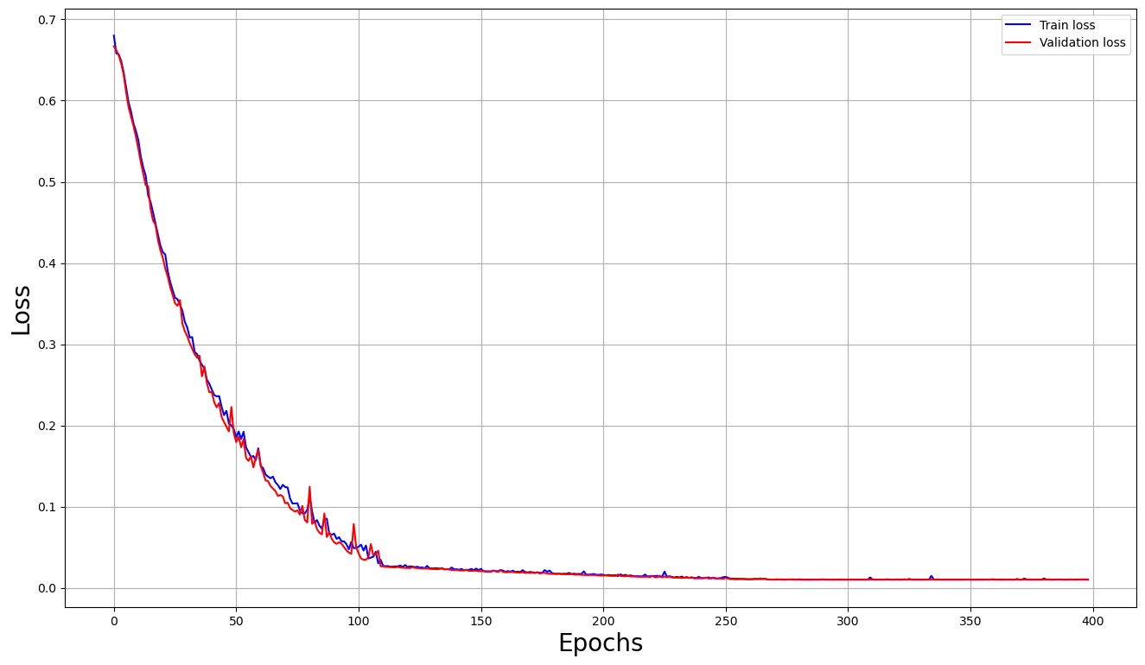
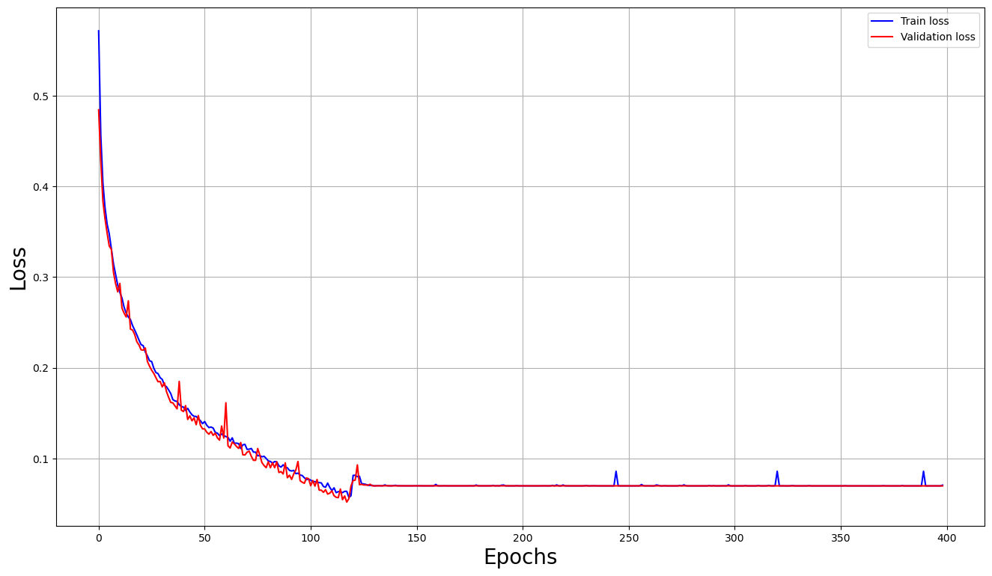
Convergence of Losses: with the increasing of epochs number, blue and red lines decrease significantly. This drastic decrease shows that the model has effectively learned.
Stability and Overfitting: lines remain close to each other, which means the model is not just memorizing. It is also generalizing well to unseen data. No signs of underfitting because loss is low. Also, there is no sign of significant overfitting, since the training loss decreases while the validation loss decreases too.
RED LINE-VALIDATION LOSS
BLUE LINE-TRAINING LOSS

Slide 22
6. Discussion
The model in our project demonstrates high performance in both types of datasets used. CT and MRI are two different medical imaging techniques, but there might be some factors applied in our model, which have a high impact.
Use of CNN(Convolutional Neural Network), which is good for capturing features of images. In both CT scans and MRIs, edges, shapes, and textures are important, so the use of CNN has a high impact on results achieved.
Also, preprocessing techniques such as resizing, normalization, and augmentation have helped in minimizing differences between CT scans and MRIs. This provides high performance in both types.

Slide 23
7. Conclusions
This thesis uses deep learning, specifically the use of Convolutional Neural Networks in medical images, aiming at tumor identification. We have created a model which aids in early diagnosis, for both types of medical images, CT scans, and MRIs. The results demonstrated the high accuracy and effectiveness of deep learning in learning complex images. The model is effective in both MRIs and CT scans. The accuracy for the detection of brain tumors in MRIs was 98.97%. For CT lung scans the accuracy for training was 99.6767%. Also, the model achieved satisfying results in unseen data.

Slide 24
8. Future Work
For future work, this study can be extended by incorporating larger and more diverse datasets. Also, exploring datasets collected from demographic and different geographic backgrounds.

